Slide 1
Darkweb analysis
Some missing attributes first: global IDs across forums not available, so user-forum analysis not possible.
Is thread-posts-replies data available for forums ? Currently only postsID is available which is unique for every post.
The user network from the API is created based on common topics across users – in my scenario, I have a feeling that it is not a good way to consider a social network based on such links – it is neither a human friend network nor a diffusion network (thread-replies).
The API returns duplicated results.
Some questions about forum structure – is there a way to filter posts by topics, also are there any ratings associated with threads/posts to denote important ones?

Slide 2
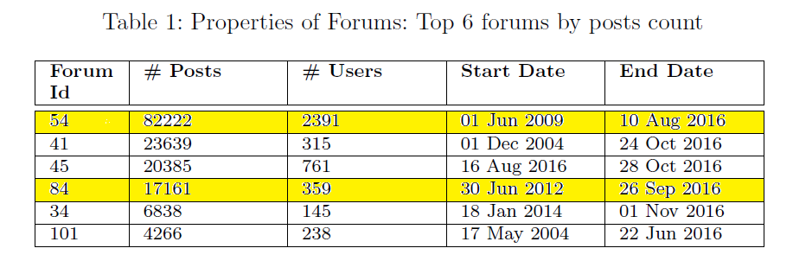
Data Stats
Extracted 300k messages filtered by scraped date between August and Nov 2016 using API
Removed duplicated results – 192K posts.
Total users – 5887
Jana mam’s important forums – 40, 48, 54, 84, 89, 125 – except 54 and 84, had few posts for other forums in the current data – currently looks like no provision to extract data based on specific forums.

Slide 3
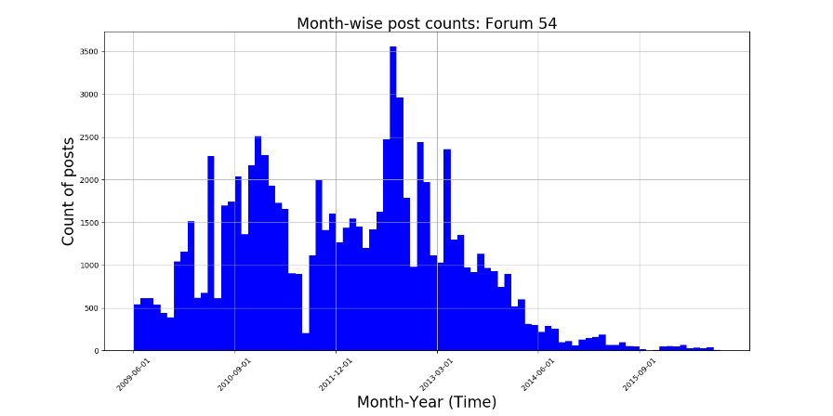
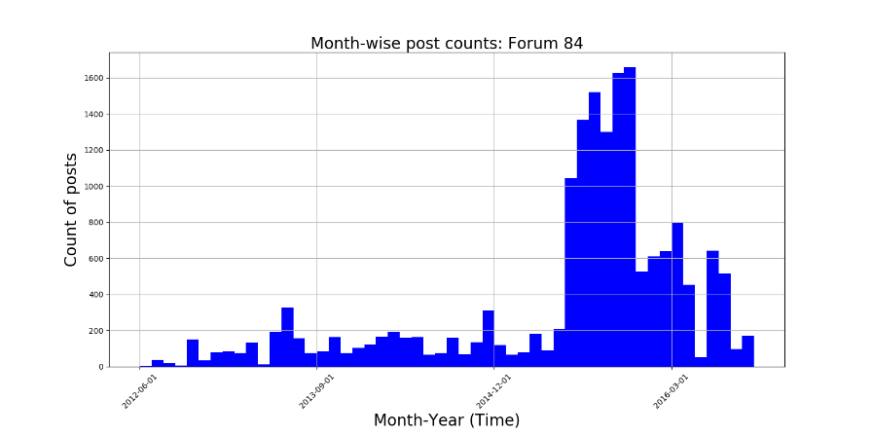
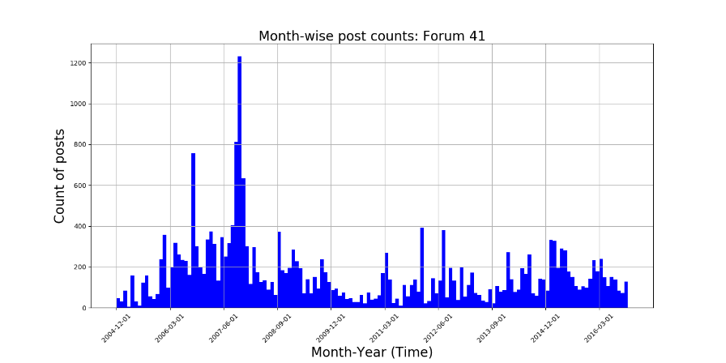
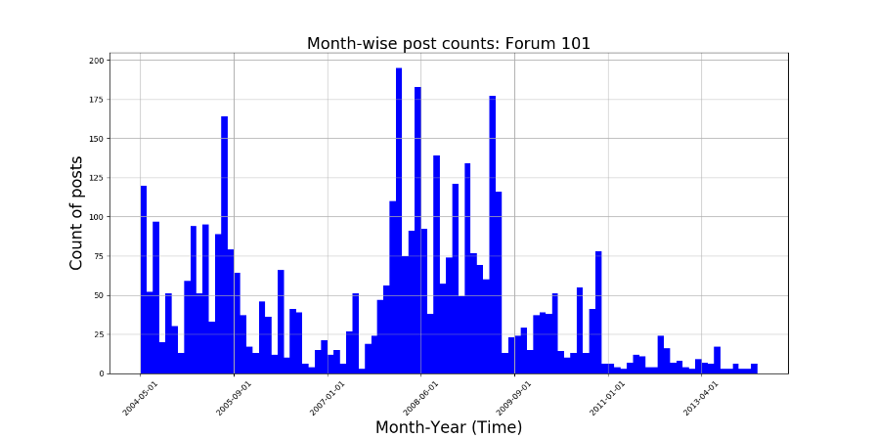
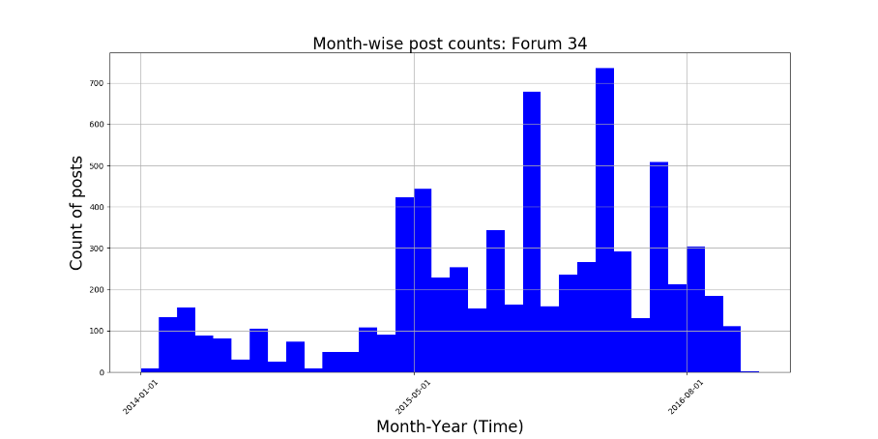
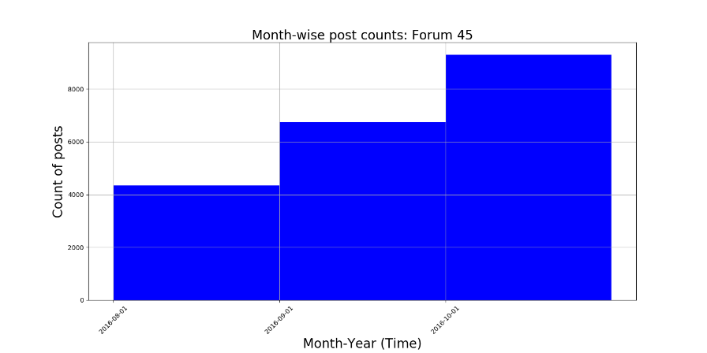
Posting trend – User posts count by month

Slide 4
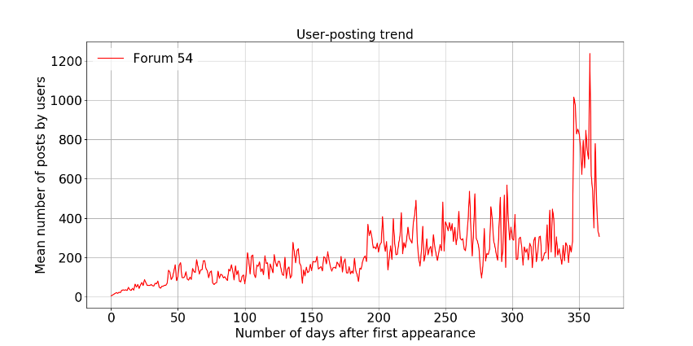
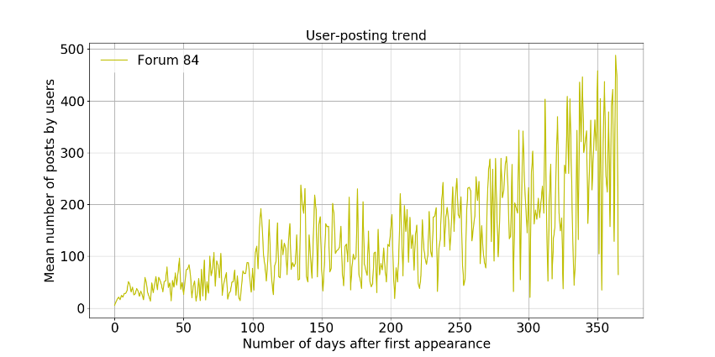
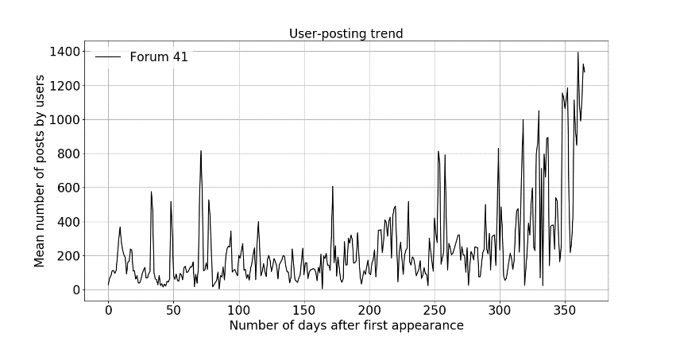
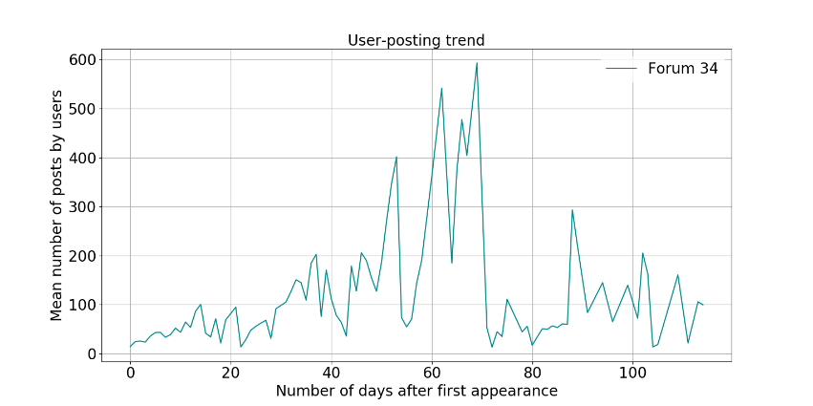
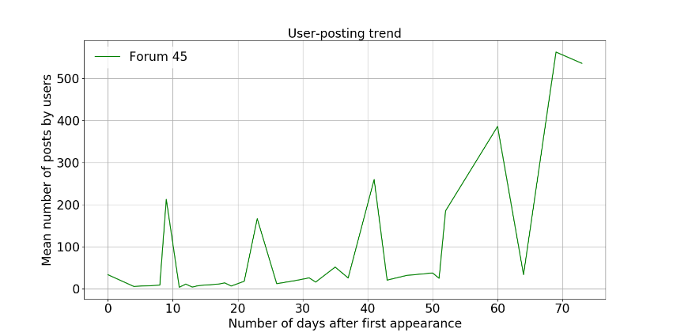
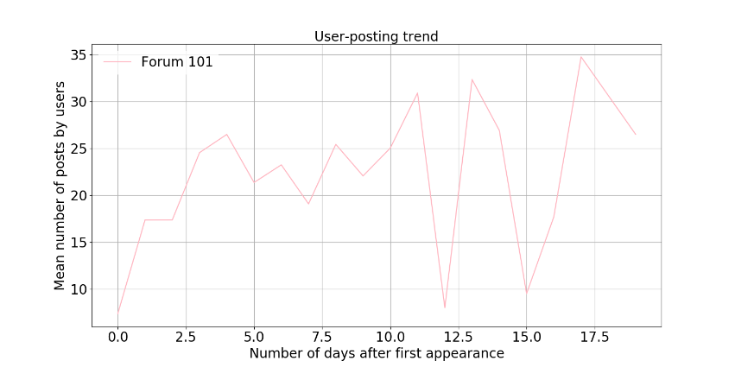
User posts count vs User age (days) – 1 year

Slide 5
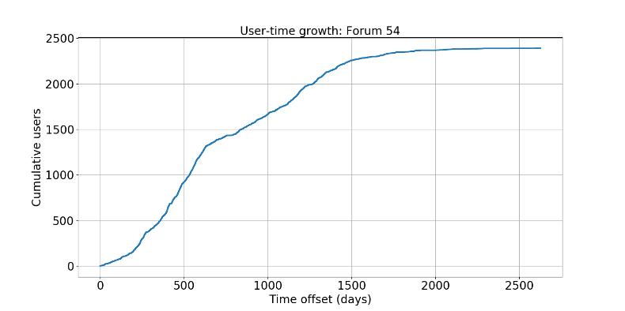
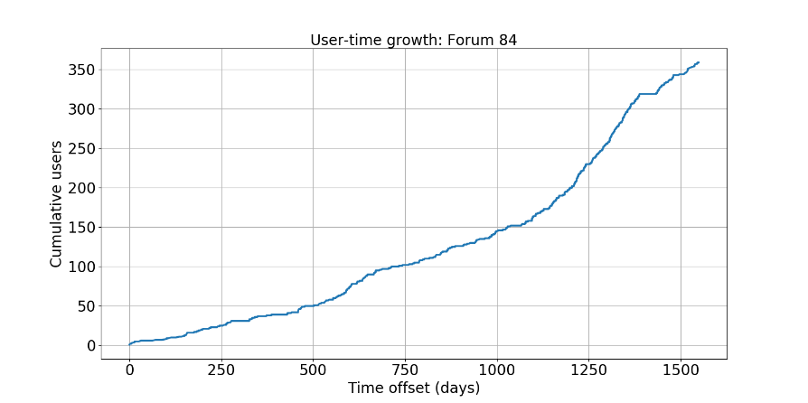
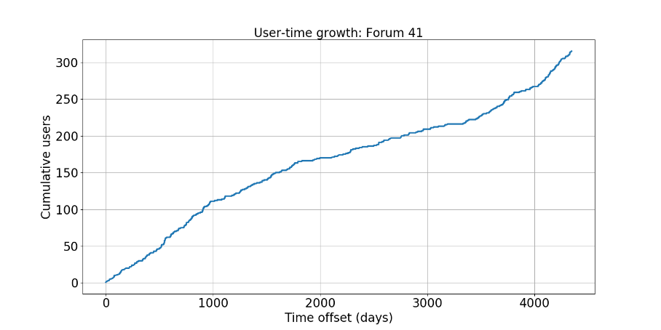
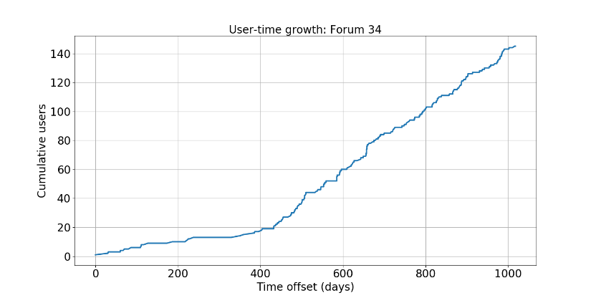
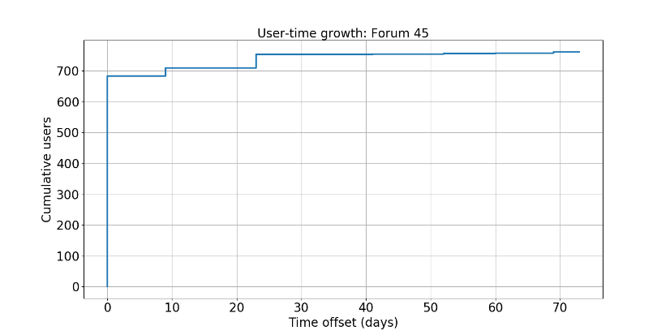
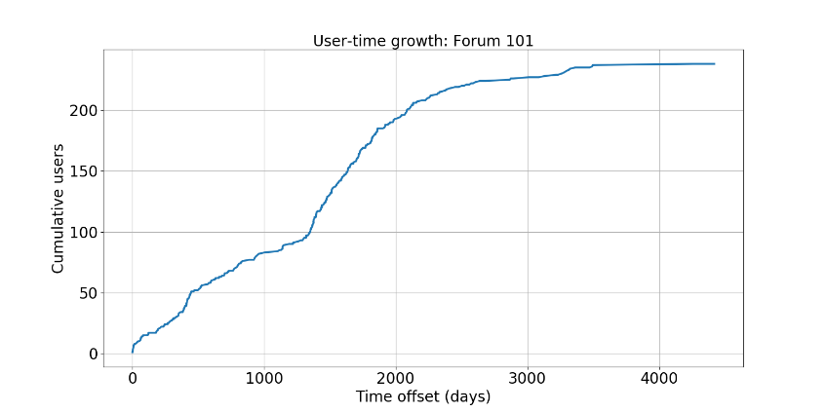
User growth by time

Slide 6
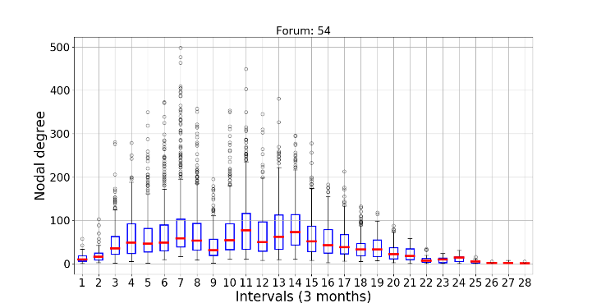
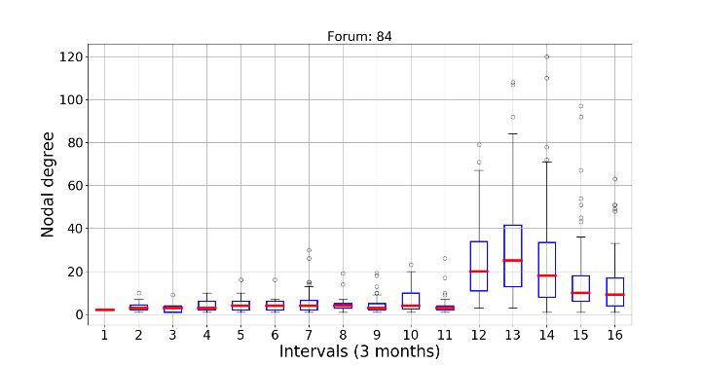
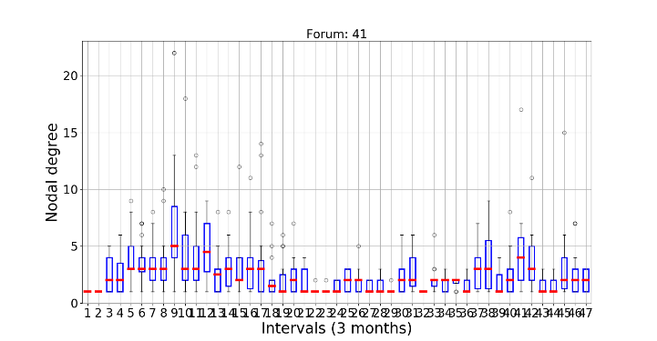
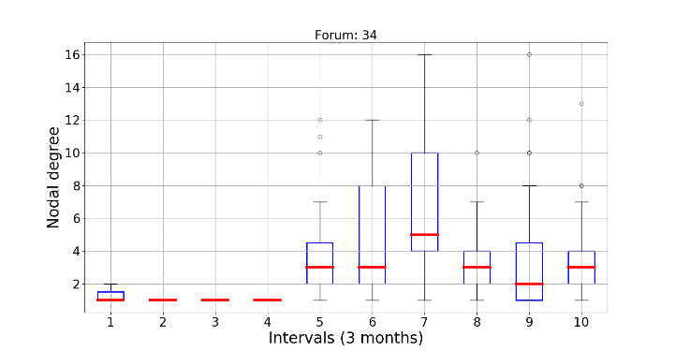
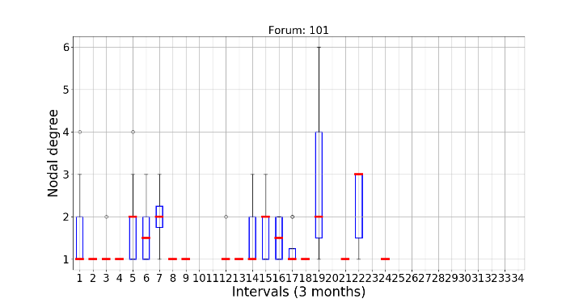
Network analysis
Created network based on posts grouped by 3 consecutive months – edges created between users if they posted on same day – undirected network !!!!
Nodal degrees follow the posts dynamics – because the network resembles posts trend !!!

Slide 7
Some observations
Did not proceed with network analysis – the network model does not look right – I feel we need the replies / friends network to do some analysis.
There have been quite some work on two aspects with regards to online forums: (i) user role /clustering across forums using ego-n/w or reply n/ws (ii) topic influence across forums.
Need to understand the user-forum-marketplace heterogeneous network as it looks like not much has been done with heterogeneous networks in online forums specially in the darkweb domain.

Slide 8
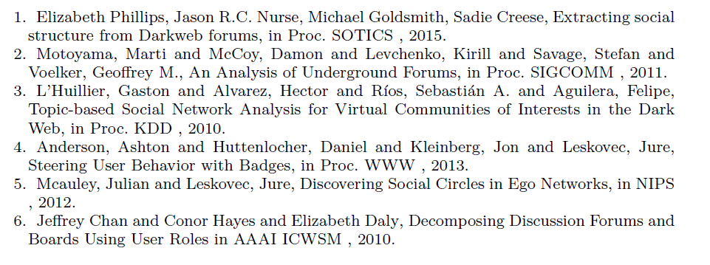
Some papers I followed

Slide 9
